Slide 1

ES -251 (Mini Project) 2025-26
Title of the Project – LC Buddy
Theme- Software(Browser Extension)
Details of team – Prakhar Singh Chauhan
Team member 2 – Shagun Singh
Team member 3 – Pawani Sachna
Team member 4 – Rudraksh Shahu

Slide 2
LC Buddy – Guided Problem Solving Assistant
Proposed Solution (Describe your Idea/Solution/Prototype)
LC Buddy is a browser extension that guides beginners step-by-step while solving problems on LeetCode and analyzes their code to provide complexity insights.
It prevents beginners from jumping directly to solutions by encouraging structured thinking and guided problem-solving.
LC Buddy acts as an interactive mentor that promotes algorithmic thinking through guided hints and real-time code analysis.

Slide 3
TECHNICAL APPROACH
• Frontend: JavaScript, React, Chrome Extension APIs for building the browser extension UI and interaction with the webpage.
• Backend: FastAPI for handling code analysis requests and generating guided hints.
• Database: SQLite for storing problem metadata, analysis logs, and user interaction data.
• Integration: DOM manipulation to read code from the LeetCode editor and provide insights inside the page.

Slide 4
FEASIBILITY AND VIABILITY
Potential Challenges and Risks
The current prototype is limited to browser environments and lacks cross-platform support for other coding platforms
.
Strategies for Overcoming These Challenges
The project is planned as an Open-source initiative, allowing developers to contribute and extend support for more platforms. Community contributions can help expand the extension to multiple coding platforms and improve its functionality over time.

Slide 5
IMPACT AND BENEFITS
LC Buddy helps beginners develop structured problem-solving skills while practicing on platforms like LeetCode. It encourages learners to think through algorithms step-by-step instead of directly relying on solutions.
Creates a collaborative open-source learning tool where developers can contribute and improve the platform.
Provides real-time insights such as complexity analysis and guided hints that enhance the learning experience.

Slide 6
RESEARCH AND REFERENCES
• FastAPI Documentation – Used for designing the backend APIs for code analysis and hint generation.
• React Documentation – Used for building the interactive user interface of the browser extension.
• Algorithm Design and Complexity Analysis concepts from Introduction to Algorithms (CLRS) – Reference for time complexity and algorithm pattern detection.

Slide 7
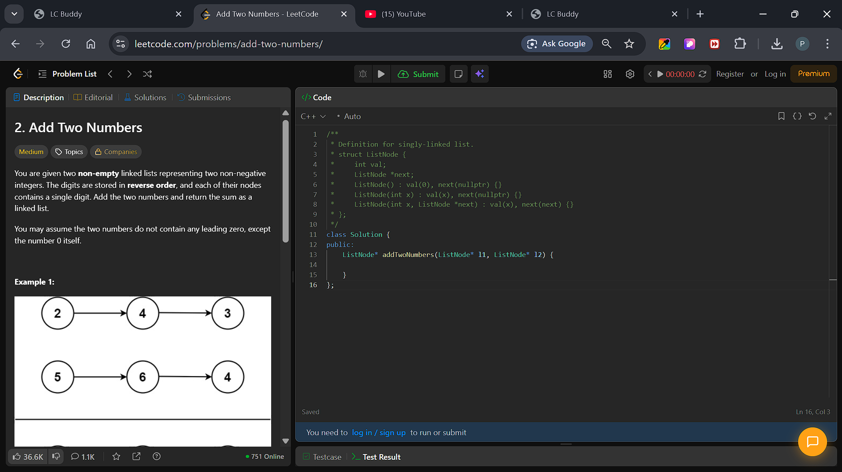

Slide 8
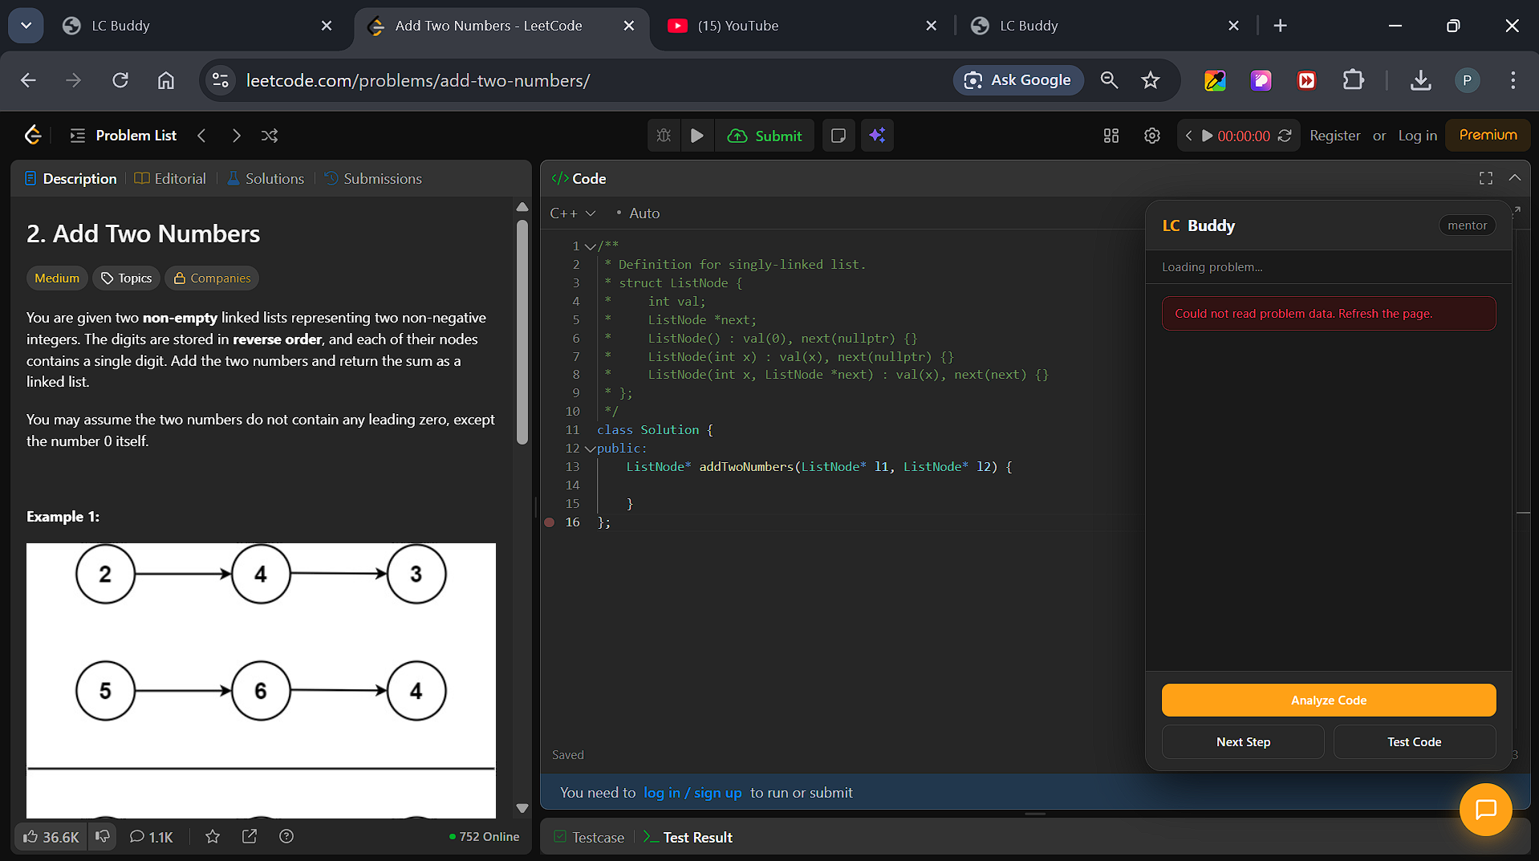

Slide 9
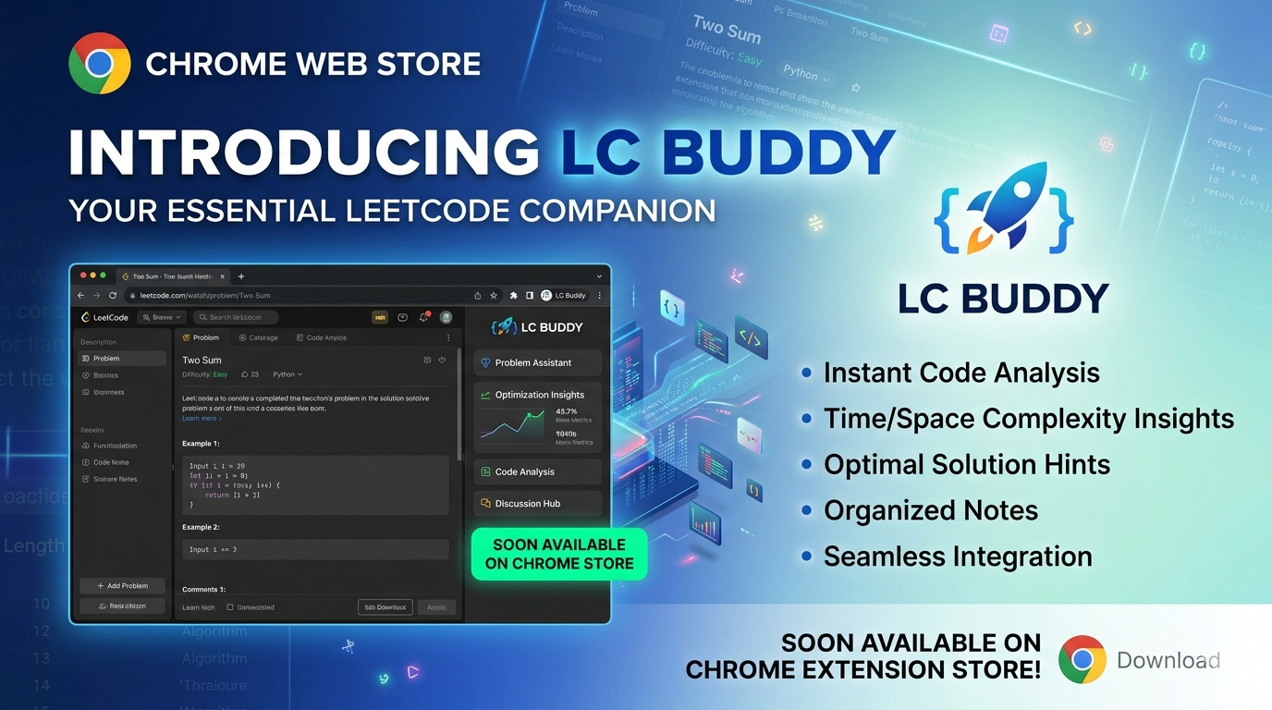

Slide 10
lcbuddycloud.netlify.app

Slide 11
IMPORTANT INSTRUCTIONS
Please ensure below pointers are met while submitting the Idea PPT:
Kindly keep the maximum slides limit up to six (6). ( Including the title slide)
Try to avoid paragraphs and post your idea in points /diagrams / Infographics /pictures
Keep your explanation precise and easy to understand
Idea should be unique and novel.
You can only use provided template for making the PPT without changing the idea details pointers (mentioned in previous slides).
You need to save the file in PDF and upload the same on portal. No PPT, Word Doc or any other format will be supported.

